Slide 1
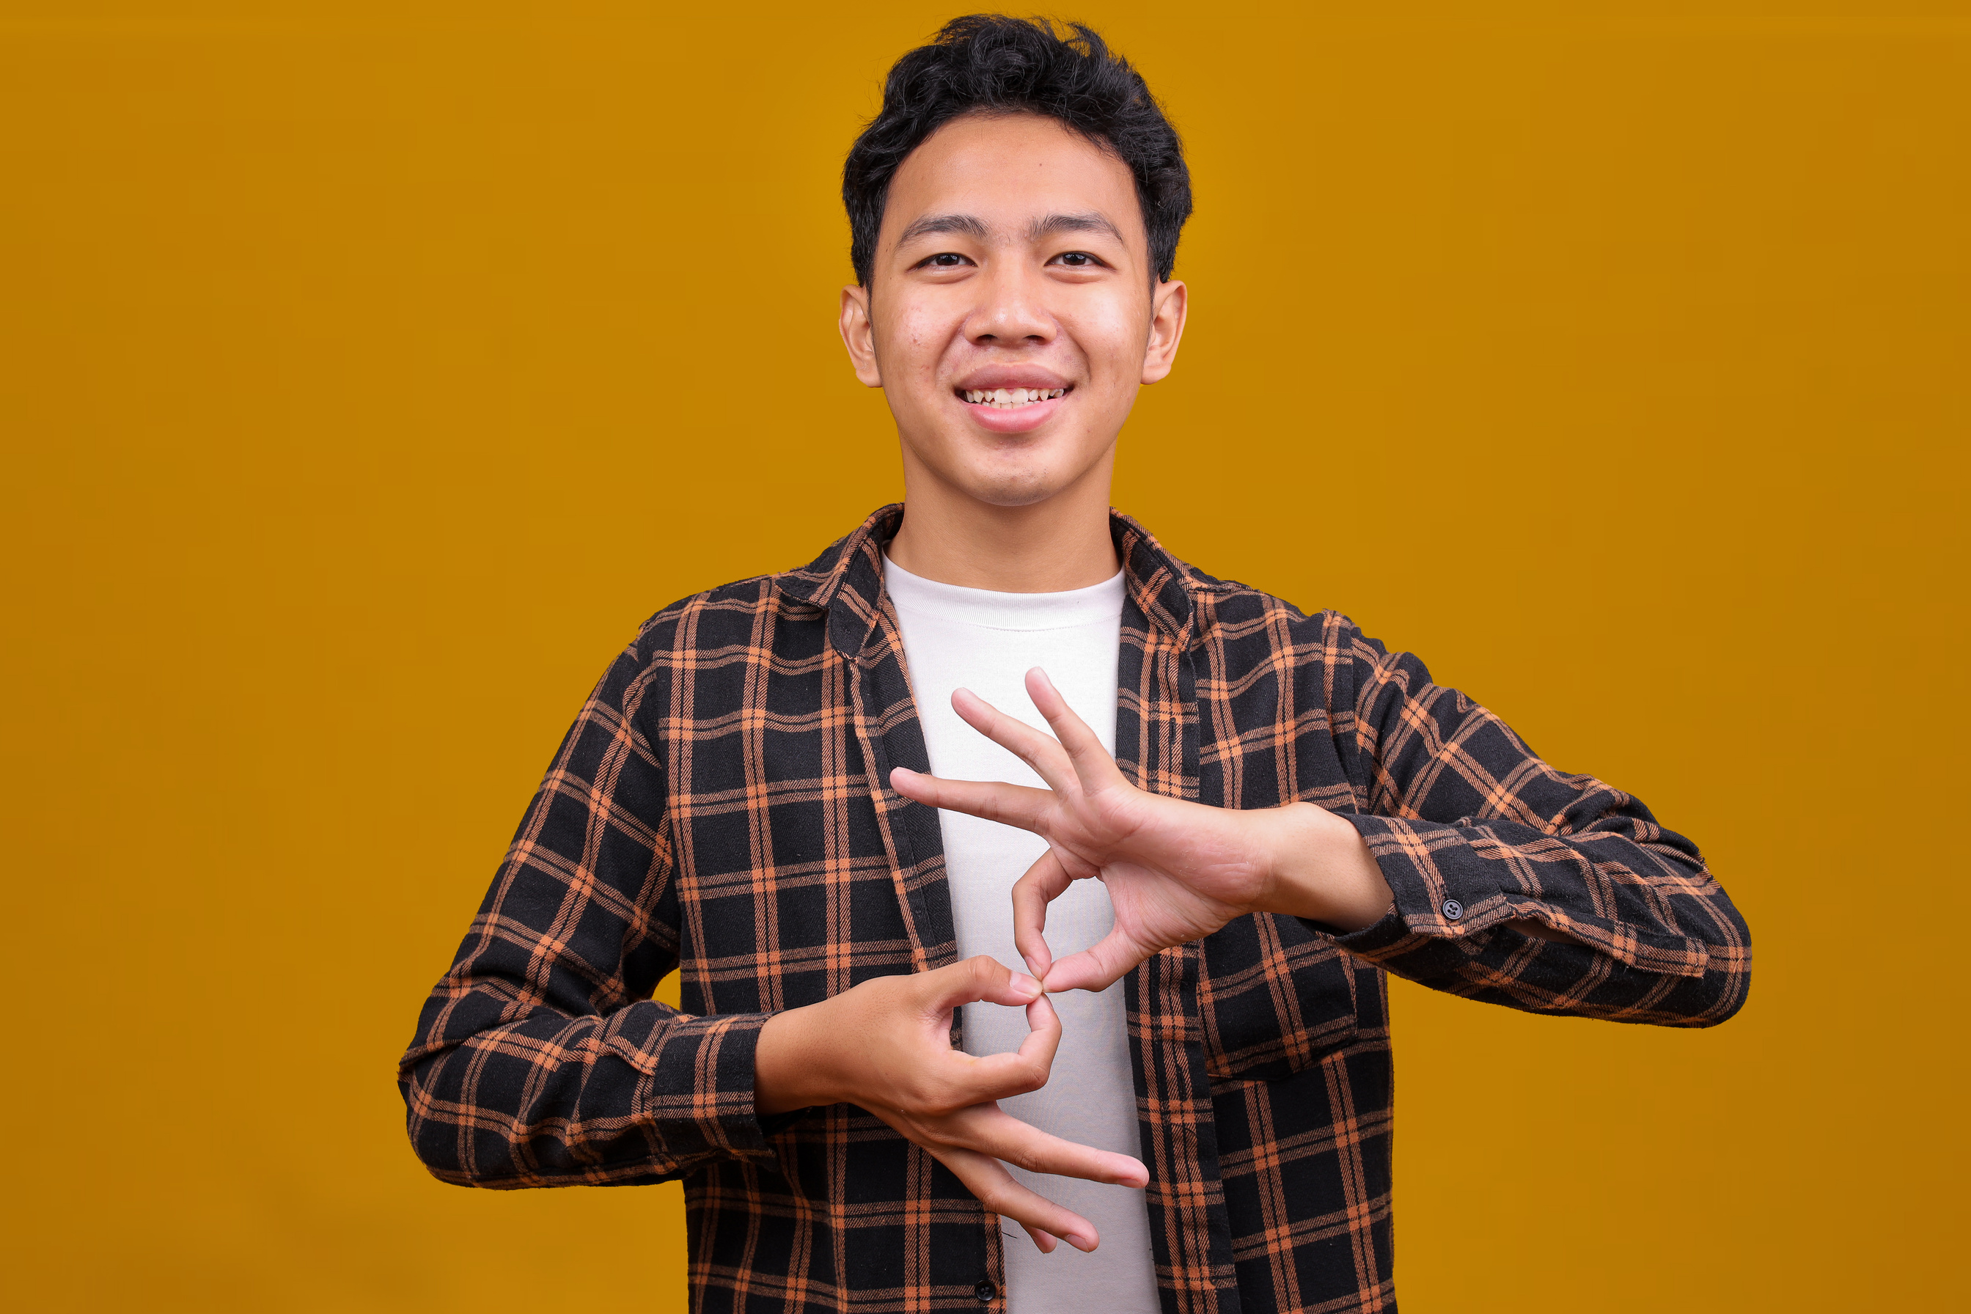
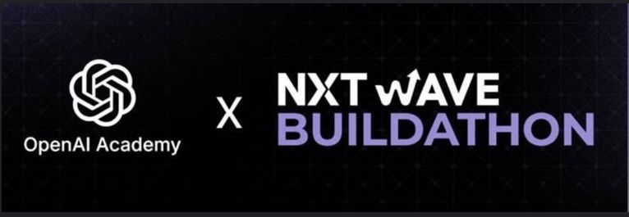
GESTURE SENSE
A Deep Learning-Based Model for Real-Time Sign Language Recognition and Text Generation
Bridging communication gaps through the power of AI and vision

Slide 2


The Communication Gap
PROBLEM STATEMENT
Millions of deaf and mute individuals rely on sign language to communicate.
Unfortunately, most people do not understand sign language.
This creates a serious communication barrier in daily life — in education, workplaces, hospitals, and public spaces.

Slide 3

OUR OBJECTIVE
To develop an intelligent AI system that can:
Recognize sign language gestures from images, videos, or live camera feed.
Convert them into readable text and speech for easy understanding.
Enable seamless communication between the deaf/mute and hearing communities.

Slide 4



HOW GESTURE SENSE WORKS
2
The model detects and identifies the gesture using deep learning.
3
1
Converts the recognized sign into text output.
Capture the sign using a camera or uploaded media.
4
Translates the text into speech

Slide 5



FEATURES OF GESTURE SENSE
Real-time sign detection using webcam
Text generation and speech output
Upload image for alphabet recognition
Interactive web-based interface
Upload video for continuous sign translation
Easy-to-use, accessible design for everyone

Slide 6




ARCHITECTURE OVERVIEW
Input: Camera / Image / Video
1
Preprocessing: Frame extraction and image enhancement
2
Model: CNN (ResNet -18)
Framework: PyTorch
3
Output: Recognized text + Text-to-Speech conversion+
Video to text and speech
4
Display: Output shown on the website interface
5

Slide 7
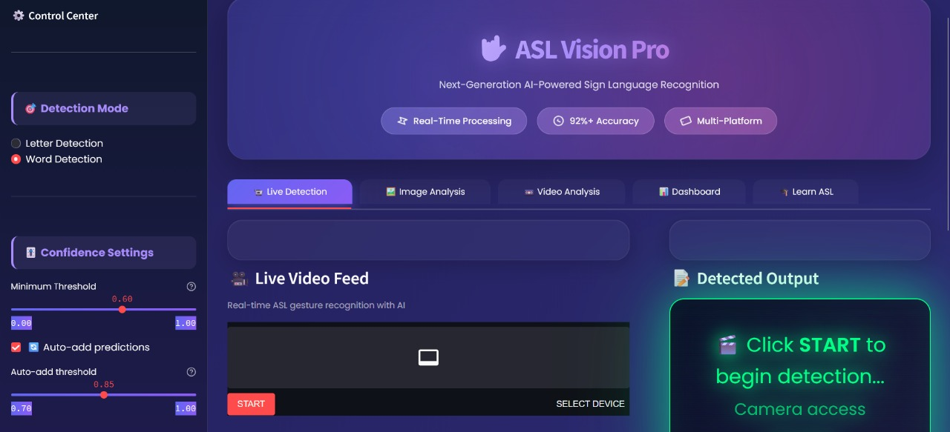
WEBSITE OVERVIEW

Slide 8

FUTURE ENHANCEMENTS
Introduce word-level and sentence-level gesture detection.
Add reverse translation (Text → Sign Animation).
Build a mobile app version for on-the-go accessibility.
Integrate wearable glove sensors for improved precision.
Enable multilingual support for different sign languages.

Slide 9


